Slide 1
SPACE EXPLORATION
MISSION
0001
PITCH DECK
INFOGRAPHICS
Here is where this template begins

Slide 2
ABOUT SPACE EXPLORATION MISSION PITCH DECK INFOGRAPHICS
This template contains an assortment of complementary infographic resources for the Space Exploration Mission Pitch Deck presentation.
These infographics are adapted to the style of the aforementioned presentation, so you can insert them easily and have them completely integrated at once. You just need to do the following:
Select the element that you want to copy
Right-click and choose “Copy”
Go to the slide where you want the element to appear
Right-click and choose “Paste”

Slide 3
SPACE EXPLORATION MISSION
MARS
NEPTUNE
Mars is actually a very cold place
Neptune is the farthest planet from the Sun
02
01
03
VENUS
Venus has extremely high temperatures

Slide 4
SPACE EXPLORATION MISSION
MARS
VENUS
Mars is actually a very cold place
Venus has extremely high temperatures
MERCURY
SATURN
Mercury is the closest planet to the Sun
Saturn is a gas giant with several rings

Slide 5
SPACE EXPLORATION MISSION
VENUS
Venus has extremely high temperatures
MARS
MERCURY
Mars is actually a very cold place
Mercury is the closest planet to the Sun

Slide 6
SPACE EXPLORATION MISSION
Mars is actually a very cold place
MARS
VENUS
Venus has extremely high temperatures
Mercury is the closest planet to the Sun
MERCURY
SATURN
Saturn is a gas giant with several rings

Slide 7
SPACE EXPLORATION MISSION
75%
60%
55%
MARS
VENUS
MERCURY
Mars is actually a very cold place
Venus has extremely high temperatures
Mercury is the closest planet to the Sun

Slide 8
SPACE EXPLORATION MISSION
US
VS
THEM
Mercury is the closest planet to the Sun and the smallest one of all the planets in the Solar System
Venus is the second planet from the Sun. It’s terribly hot, even hotter than Mercury

Slide 9
SPACE EXPLORATION MISSION
 |  | LEVEL 1 | Venus has extremely high temperatures
1.543° | INCLINATION
 |  | LEVEL 2 | Mercury is the closest planet to the Sun
5.1° | LATITUDE
 |  | LEVEL 3 | Saturn is a gas giant with several rings
27.322 DAYS | AROUND EARTH

Slide 10
SPACE EXPLORATION MISSION
SOLUTION
Venus is the second planet from the Sun. It’s terribly hot, even hotter than Mercury
PROBLEM
Mercury is the closest planet to the Sun and the smallest one in the Solar System

Slide 11
SPACE EXPLORATION MISSION
STEP 1
STEP 3
STEP 5
Mercury is the closest planet to the Sun
Venus has a
beautiful name
Neptune is the farthest planet from the Sun
STEP 2
STEP 4
Jupiter is the biggest planet of them all
Saturn is the ringed planet and a gas giant

Slide 12
SPACE EXPLORATION MISSION
Mars is actually a very cold place
MISSION
VISION
Venus has extremely high temperatures
Mercury is the closest planet to the Sun
VALUES

Slide 13
SPACE EXPLORATION MISSION
CHALLENGE
SOLUTIONS
Mercury is the closest planet to the Sun
Venus has a
beautiful name
RESULTS
Jupiter is the biggest planet of them all

Slide 14
SPACE EXPLORATION MISSION
TOTAL BUDGET
$130,000
BUDGET
Mercury | $20,000
Venus | $30,000
Saturn | $50,000
Earth | $10,000
Pluto | $20,000
BUDGET MODEL

Slide 15

SPACE EXPLORATION MISSION
30%
MERCURY
30%
Mercury is the closest planet to the Sun
MARS
Mars is actually a very cold place
40%
VENUS
Venus has extremely high temperatures
Follow the link in the graph to modify its data and then paste the new one here. For more info, click here

Slide 16
SPACE EXPLORATION MISSION
ORBIT 1
Mercury is the closest planet to the Sun
ORBIT 2
Jupiter is a gas giant and the biggest planet
ORBIT 3
Despite being red, Mars is a cold place

Slide 17
SPACE EXPLORATION MISSION
PLANS | SUPPORT | PATRON | ANGEL
COST | $30/month | $100/month | $1,000/month
BENEFITS | Merchandising | Monthly gifts | Annual travel

Slide 18
SPACE EXPLORATION MISSION
STRATEGY
TEAM 1
TEAM 2
VENUS
JUPITER
MERCURY
EARTH
Venus has a nice name but is hot
Jupiter is the biggest planet of them all
Mercury is the closest planet to the Sun
Earth is the third planet from the Sun

Slide 19
SPACE EXPLORATION MISSION
AWARDS
20XX
20XX
Mercury is the smallest planet of them all
Jupiter is a gas giant and the biggest planet

Slide 20
SPACE EXPLORATION MISSION
CORE VALUES
MISION
VISION
Jupiter is a gas giant and the biggest planet
Mercury is the closest planet to the Sun
Venus has a beautiful name but is very hot
Neptune is the farthest planet from the Sun
Despite being red, Mars is a cold place
Saturn is a gas giant and has several rings

Slide 21
SPACE EXPLORATION MISSION
50%
25%
60%
MERCURY
JUPITER
EARTH
Mercury is the smallest planet
Jupiter is the biggest planet of them all
Earth is the third planet from the Sun

Slide 22
SPACE EXPLORATION MISSION
Opportunity assessment
Market analysis
Transition manager
Ongoing operations
KEY ACTIVITIES
Activity 1 Activity 2 Activity 3 | Activity 4 Activity 5 Activity 6 | Activity 7 Activity 8 Activity 9 | Activity 10 Activity 11 Activity 12
DELIVERABLES
Mercury is the closest planet to the Sun and the smallest one in the entire Solar System |  | Mars is a cold place full of iron oxide dust, which gives the planet its reddish cast

Slide 23
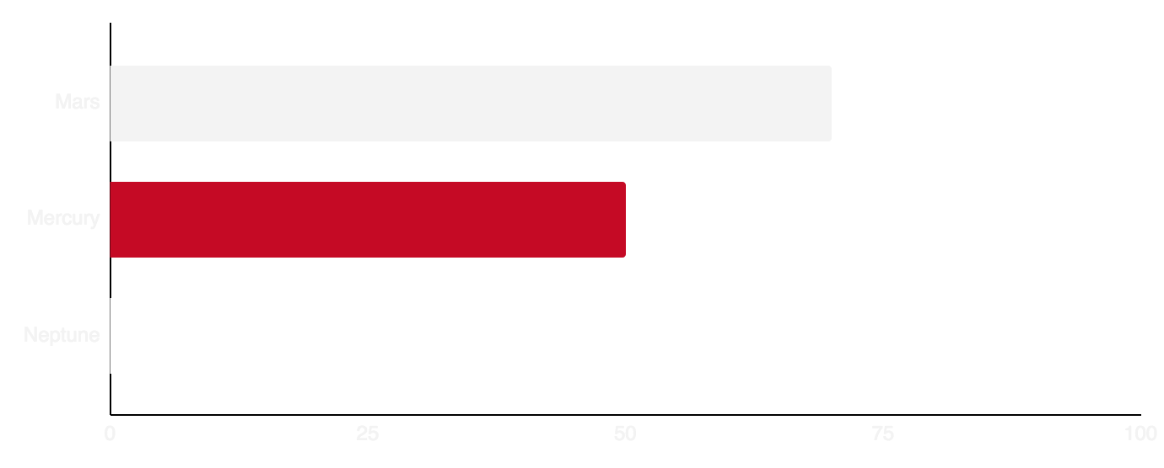
SPACE EXPLORATION MISSION
70%
50%
100%
Revenue
$981,000
PERFORMANCE
Despite being red, Mars is a cold place
Follow the link in the graph to modify its data and then paste the new one here. For more info, click here

Slide 24
SPACE EXPLORATION MISSION
 | HARDWARE | SOFTWARE | SPACESHIP
COMPETITOR 1 | 8/10 | 7/10 | 6/10
COMPETITOR 2 | 7/10 | 6/10 | 8/10
COMPETITOR 3 | 8/10 | 6/10 | 7/10

Slide 25
SPACE EXPLORATION MISSION
JUPITER
CEO
MERCURY
NEPTUNE
Department head
Department head
PLUTO
MOON
Manager
Manager
MARS
EARTH
SATURN
CERES
Employee
Employee
Employee
Employee

Slide 26
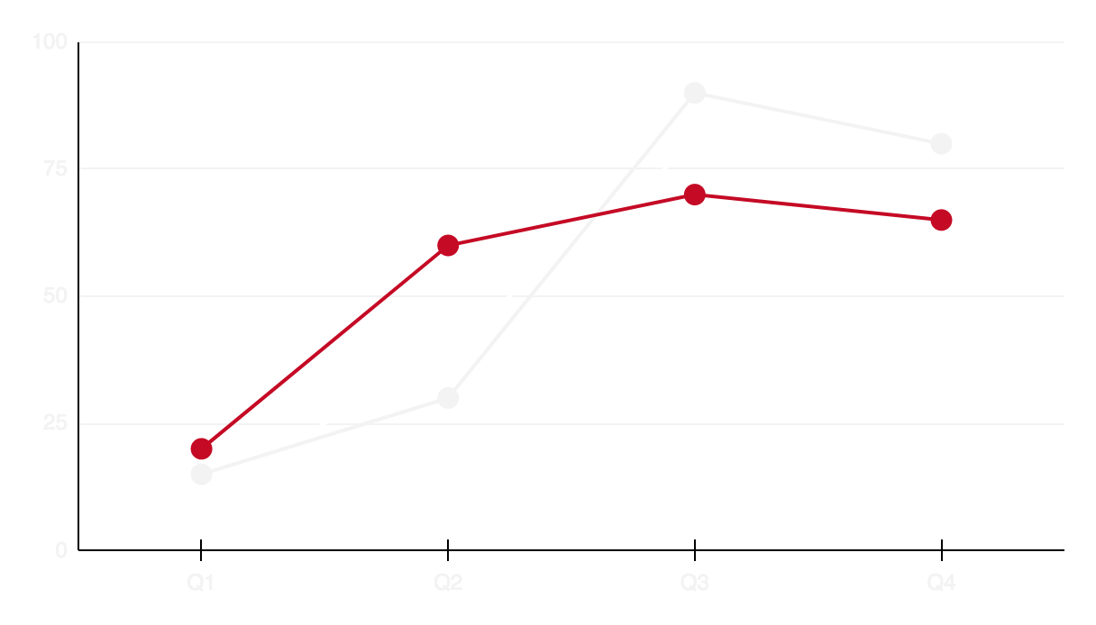
SPACE EXPLORATION MISSION
VENUS
+80%
Venus has a beautiful name but is hot
MERCURY
+65%
Mercury is the closest planet to the Sun
JUPITER
+45%
Jupiter is a gas giant and the biggest planet
Follow the link in the graph to modify its data and then paste the new one here. For more info, click here

Slide 27
SPACE EXPLORATION MISSION
ALLIANCES
NEPTUNE
Neptune is the farthest planet from the Sun
JUPITER
Jupiter is the biggest planet of them all

Slide 28
SPACE EXPLORATION MISSION
NEPTUNE
Neptune is the farthest planet from the Sun
FINANCIAL TEAM
JUPITER
Jupiter is a gas giant and the biggest planet
CEO
MERCURY
Mercury is the closest planet to the Sun
TECHNICAL TEAM
Venus has a beautiful name but is hot
VENUS
EARTH
Earth is the third planet from the Sun

Slide 29
SPACE EXPLORATION MISSION
TECHNOLOGY
Mercury is the closest planet to the Sun
ADVENTURE
Jupiter is a gas giant and the biggest planet
SCIENCE
Despite being red, Mars is a cold place

Slide 30
SPACE EXPLORATION MISSION
VENUS
JUPITER
SATURN
Venus has a beautiful name but is hot
Jupiter is the biggest planet of them all
Saturn is a gas giant several rings
Q1 |  |  | Q2 |  |  | Q3 |  |  | Q4
Jan | Feb | Mar | Apr | May | Jun | Jul | Aug | Sep | Oct | Nov | Dec
50%
25%
20%

Slide 31
SPACE EXPLORATION MISSION
2xxx | Jan | Feb | Mar | Apr | May | Jun | Jul | Aug | Sep | Oct | Nov | Dec
Task 1
Task 2
Task 3
Mercury is the smallest planet
Ceres is located in the main asteroid belt
Saturn is composed of hydrogen and helium

Slide 32
SPACE EXPLORATION MISSION
MERCURY
MARKET SIZE
Mercury is the closest planet to the Sun
$10K
JUPITER
$5K
Jupiter is a gas giant and the biggest planet
VENUS
Venus has a beautiful name but is hot
$30K

Slide 33
Instructions for use
If you have a free account, in order to use this template, you must credit Slidesgo in your final presentation. Please refer to the next slide to read the instructions for premium users.
As a Free user, you are allowed to:
- Modify this template.
- Use it for both personal and commercial projects.
You are not allowed to:
- Sublicense, sell or rent any of Slidesgo Content (or a modified version of Slidesgo Content).
- Distribute Slidesgo Content unless it has been expressly authorized by Slidesgo.
- Include Slidesgo Content in an online or offline database or file.
- Offer Slidesgo templates (or modified versions of Slidesgo templates) for download.
- Acquire the copyright of Slidesgo Content.
For more information about editing slides, please read our FAQs or visit our blog:
https://slidesgo.com/faqs and https://slidesgo.com/slidesgo-school

Slide 34
Instructions for use (premium users)
As a Premium user, you can use this template without attributing Slidesgo.
You are allowed to:
Modify this template.
Use it for both personal and commercial purposes.
Share this template in an editable format with people who are not part of your team.
You are not allowed to:
Sublicense, sell or rent this Slidesgo Template (or a modified version of this Slidesgo Template).
Distribute this Slidesgo Template (or a modified version of this Slidesgo Template) or include it in a database or in any other product or service that offers downloadable images, icons or presentations that may be subject to distribution or resale.
Use any of the elements that are part of this Slidesgo Template in an isolated and separated way from this Template.
Register any of the elements that are part of this template as a trademark or logo, or register it as a work in an intellectual property registry or similar.
For more information about editing slides, please read our FAQs or visit our blog:
https://slidesgo.com/faqs and https://slidesgo.com/slidesgo-school

Slide 35
Infographics
You can add and edit some infographics to your presentation to present your data in a visual way.
Choose your favourite infographic and insert it in your presentation using Ctrl C + Ctrl V or Cmd C + Cmd V in Mac.
Select one of the parts and ungroup it by right-clicking and choosing “Ungroup”.
Change the color by clicking on the paint bucket.
Then resize the element by clicking and dragging one of the square-shaped points of its bounding box (the cursor should look like a double-headed arrow). Remember to hold Shift while dragging to keep the proportions.
Group the elements again by selecting them, right-clicking and choosing “Group”.
Repeat the steps above with the other parts and when you’re done editing, copy the end result and paste it into your presentation.
Remember to choose the “Keep source formatting” option so that it keeps the design. For more info, please visit our blog.

